Slide 1
How Nations Create a Sustainable, Prosperous, Equitable Economy
CLAIR BROWN, University of California, Berkeley
LERA Panel, Jan. 4 2020

Slide 2
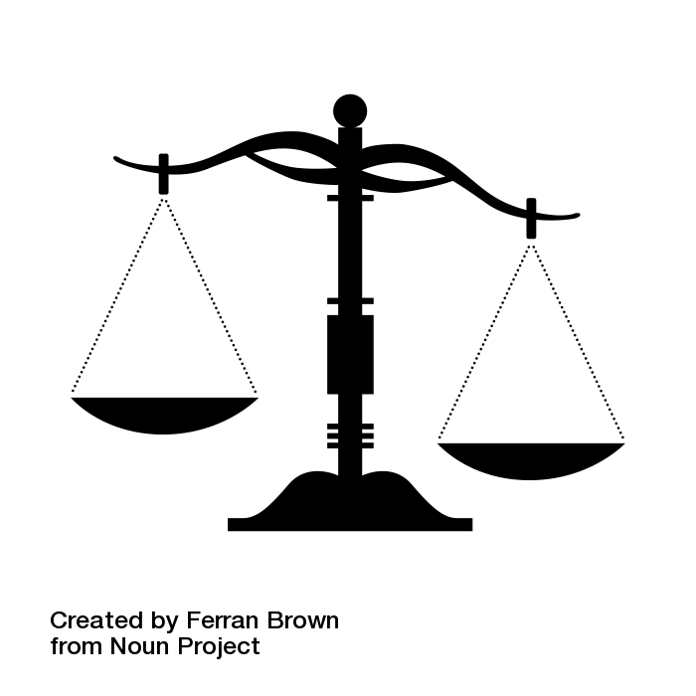
MOST CRITICAL PROBLEMS
Inequality
Climate Change

Slide 3
Inequality reduces well-being
People feel worse off as inequality grows (invidious comparisons), so inequality requires higher personal consumption across income groups.
Well-being index worsens as income inequality increases across rich countries
Inequality and well-being index inversely related

Slide 4
Inequality and CO2 emissions go together
GDP growth has increased inequality—rich grab increased GDP
GDP growth has increased CO2 emissions
Our focus on GDP growth is creating catastrophe that will make planet uninhabitable for humans.

Slide 5
Is It Possible to Create an Economy that Cares for People and the Planet?
Green New Deal

Slide 6
Green New Deal: Good Jobs in Sustainable Low-Carbon Economy
Policies to achieve specific goals:
Shared Prosperity
Good Jobs; Safety Net; Social Programs; Progressive taxes
Sustainable planetary systems
Roadmaps for renewable energy; regenerative agriculture
Reduce global suffering
UN SDGs
Sustainable Shared-Prosperity Policy Index (SSPI)

Slide 7
How to Create Change
All markets are structured: Who structures them?
Big Business for big profits (forget the common good)
Governments for the common good:
Rules & incentives & institutions
https://www.project-syndicate.org/commentary/america-presidential-election-reform-capitalism-by-clair-brown-and-simon-sallstrom-2-2019-07

Slide 8
Role of Government
Rules, incentives structure markets, along with social programs to achieve goals
Regulations structure markets to expand access, support innovation & competition, provide decent jobs, protect the environment.
Decent Jobs: living wages & hours, paid time off, worker health & safety, empower workers.
Govt plays leading role in transition to
modern, low carbon, equitable economy.

Slide 9
Sustainable Shared-Prosperity Policy Index
Three Pillars with Categories (54 Indicators)
Sustainability: Ecosystem, Land, Waste, Greenhouse Gases
Market Structure: Employment, Taxes, Property
Public Goods and Services: Education, Health Care, Infrastructure, Rights, Public Safety, Global Role
Ranking of 50 Countries by SSPI Score

Slide 10
SSPI Ranking (2018) for 50 Countries (OECD+)
Top 5: Sweden, Finland, Denmark, France, Austria
Germany, Australia, Canada, UK in Top 12
USA is #36
Bottom 10 include Mexico, Turkey, Israel, South Africa, India, China

Slide 11
Employment Policy Variables
Unemployment Benefits (Coverage)
Workplace Safety (Fatalities)
Full-time Work Hours
Minimum Wage (% of Mean Wage)
Labor Force Participation
Paid Maternity Leave
Child Labor

Slide 12
Employment Policies: Rankings
Top 4: Austria (0.86), Germany, France, Finland
USA is #36 (0.55)
Mean 0.62 (0.30 to 0.86)

Slide 13
Relationship between SSPI and Performance Measures
Positive (sig) relationship with:
UN Human Development Index
UN Sustainable Development Goals
Social Progress Indicator, Legatum Prosperity Index, Cantril Ladder
NOT related to GDP per capita

Slide 14
Sustainability Policies: Weakest Pillar
Carbon Emissions Are Too High Across All Countries (Energy)
Waste Is Too High; Management of Waste Is Inadequate
Protection of Ground Water Inadequate (Agriculture)

Slide 15
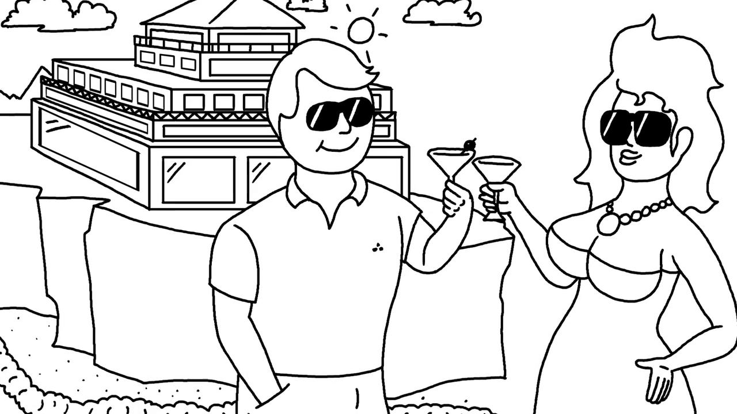
GOAL: Support good life for all people. Health of Planet Must Be Top Priority. (Don’t imitate wasteful, conspicuous consumption of rich.)

Slide 16
CLOSING THOUGHTS
We need political will and courage
to protect the environment and
to promote justice,
and courage to live with joy.
Notes:
Inequality is not essential to provide incentives. We must safeguard earth and pass on to future generations the earth as we have enjoyed it.
Countries have major control over their inequality and environmental degradation, and can “tax and transfer” and support social norms to create meaningful balanced lives in a sustainable equitable Buddhist economy.

Slide 17
Gratitude to Priya Iyer (UCB 2014) for creating deck, to IRLE for financial support, and to friends around the world for insight and support.
BUDDHIST ECONOMICS:
An enlightened approach to the dismal science
Clair Brown
Bloomsbury Press
Buddhisteconomics.net
Notes:
Insert photo of a flower here - preferably the same one as shown on the book cover

Slide 18
SSPI: Known Policies (already in place)
Reduce inequality, provide economic security and opportunity for all people.
Low-carbon Roadmaps show how to create modern sustainable economy with carbon-free energy, regenerative agriculture, and clean water.
UN Millennium Development Goals demonstrated how to reduce global hunger and poverty, and educate women and girls.

